Slide 1

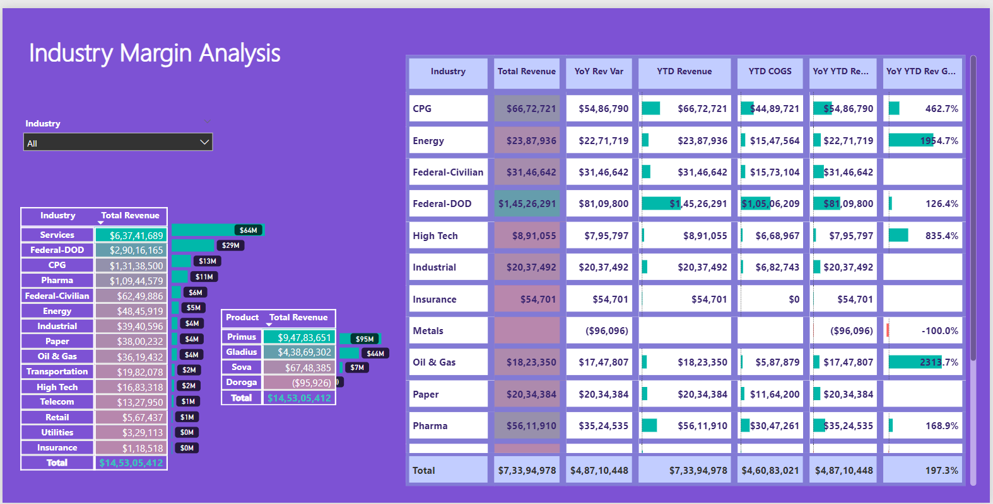
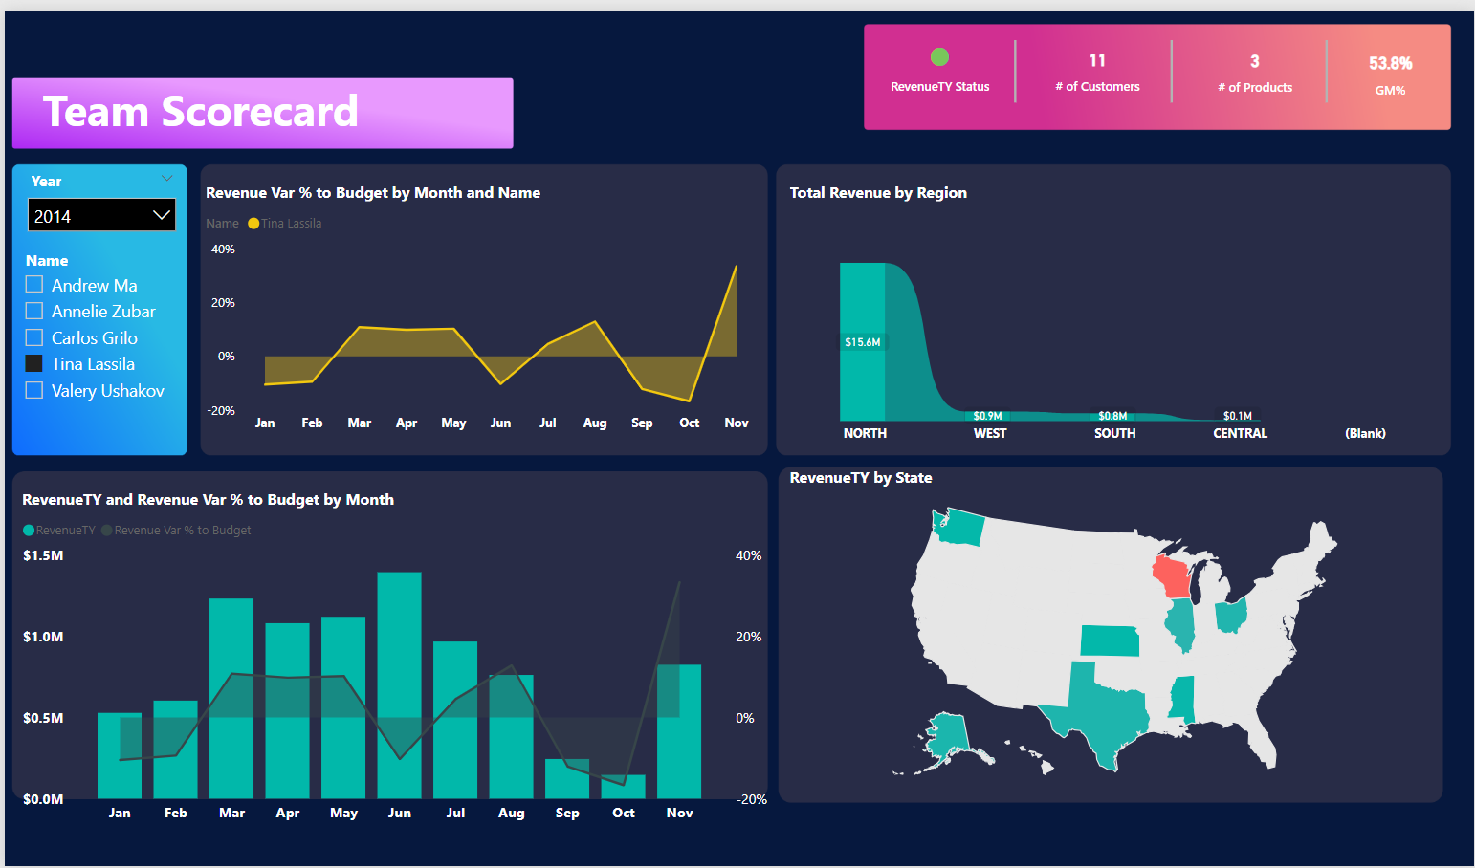
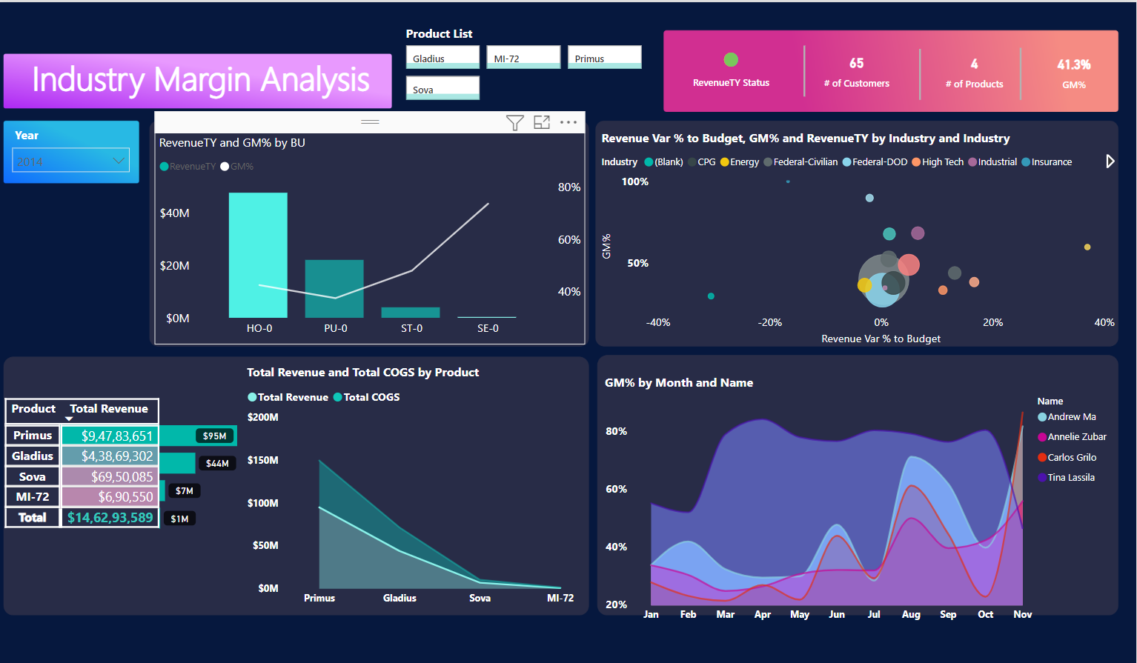


Customer Profitability Sample PBIX
Industry Margin Insights Dashboard
View in Power BI
Last data refresh:
5/14/2024 4:16:25 PM UTC
Downloaded at:
5/14/2024 4:17:07 PM UTC

Slide 2
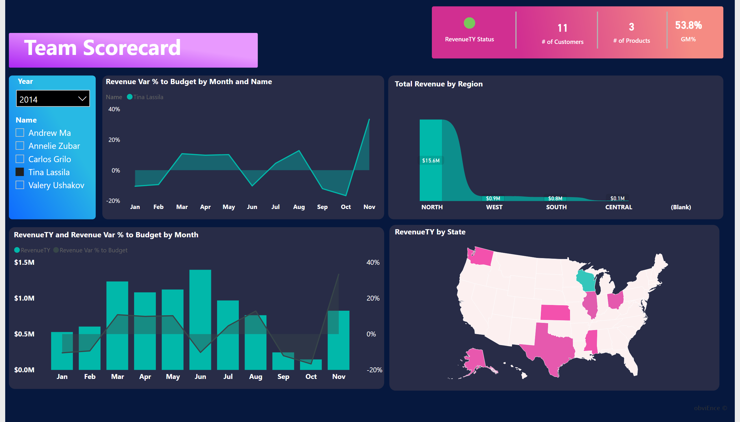
Team Scorecard
Notes:
textbox
No alt text provided
textbox
No alt text provided
slicer
No alt text provided
areaChart
No alt text provided
ribbonChart
No alt text provided
card
No alt text provided
card
No alt text provided
card
No alt text provided
card
No alt text provided
lineStackedColumnComboChart
No alt text provided
shapeMap
No alt text provided
slicer
No alt text provided
shape
No alt text provided
shape
No alt text provided
shape
No alt text provided

Slide 3
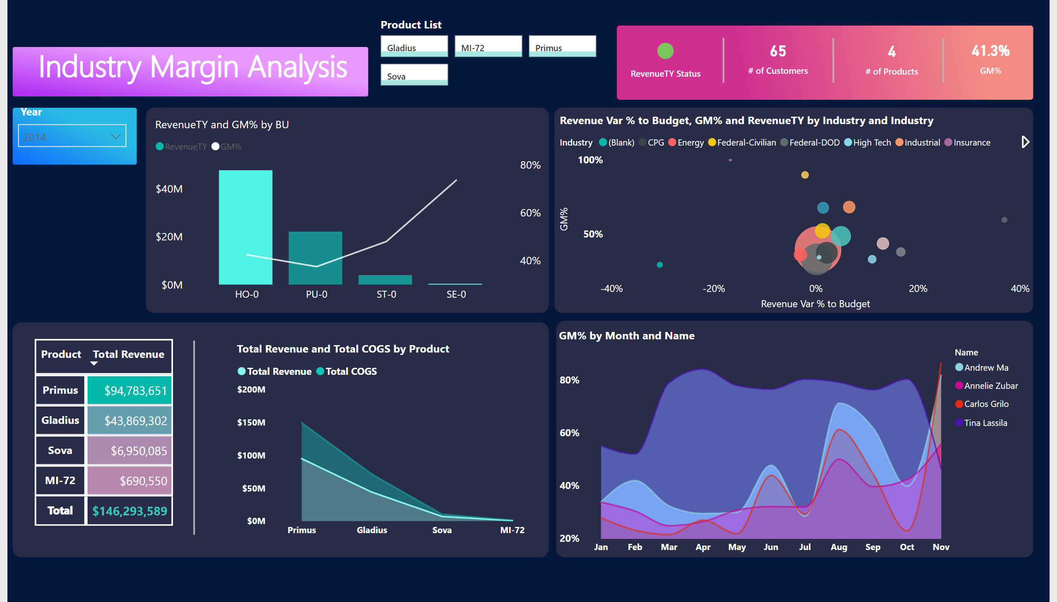
Industry Margin Analysis
Notes:
textbox
No alt text provided
areaChart
No alt text provided
slicer
No alt text provided
Product List
No alt text provided
card
No alt text provided
card
No alt text provided
card
No alt text provided
card
No alt text provided
lineClusteredColumnComboChart
No alt text provided
scatterChart
No alt text provided
pivotTable
No alt text provided
stackedAreaChart
No alt text provided
shape
No alt text provided
shape
No alt text provided
shape
No alt text provided
shape
No alt text provided

Slide 4
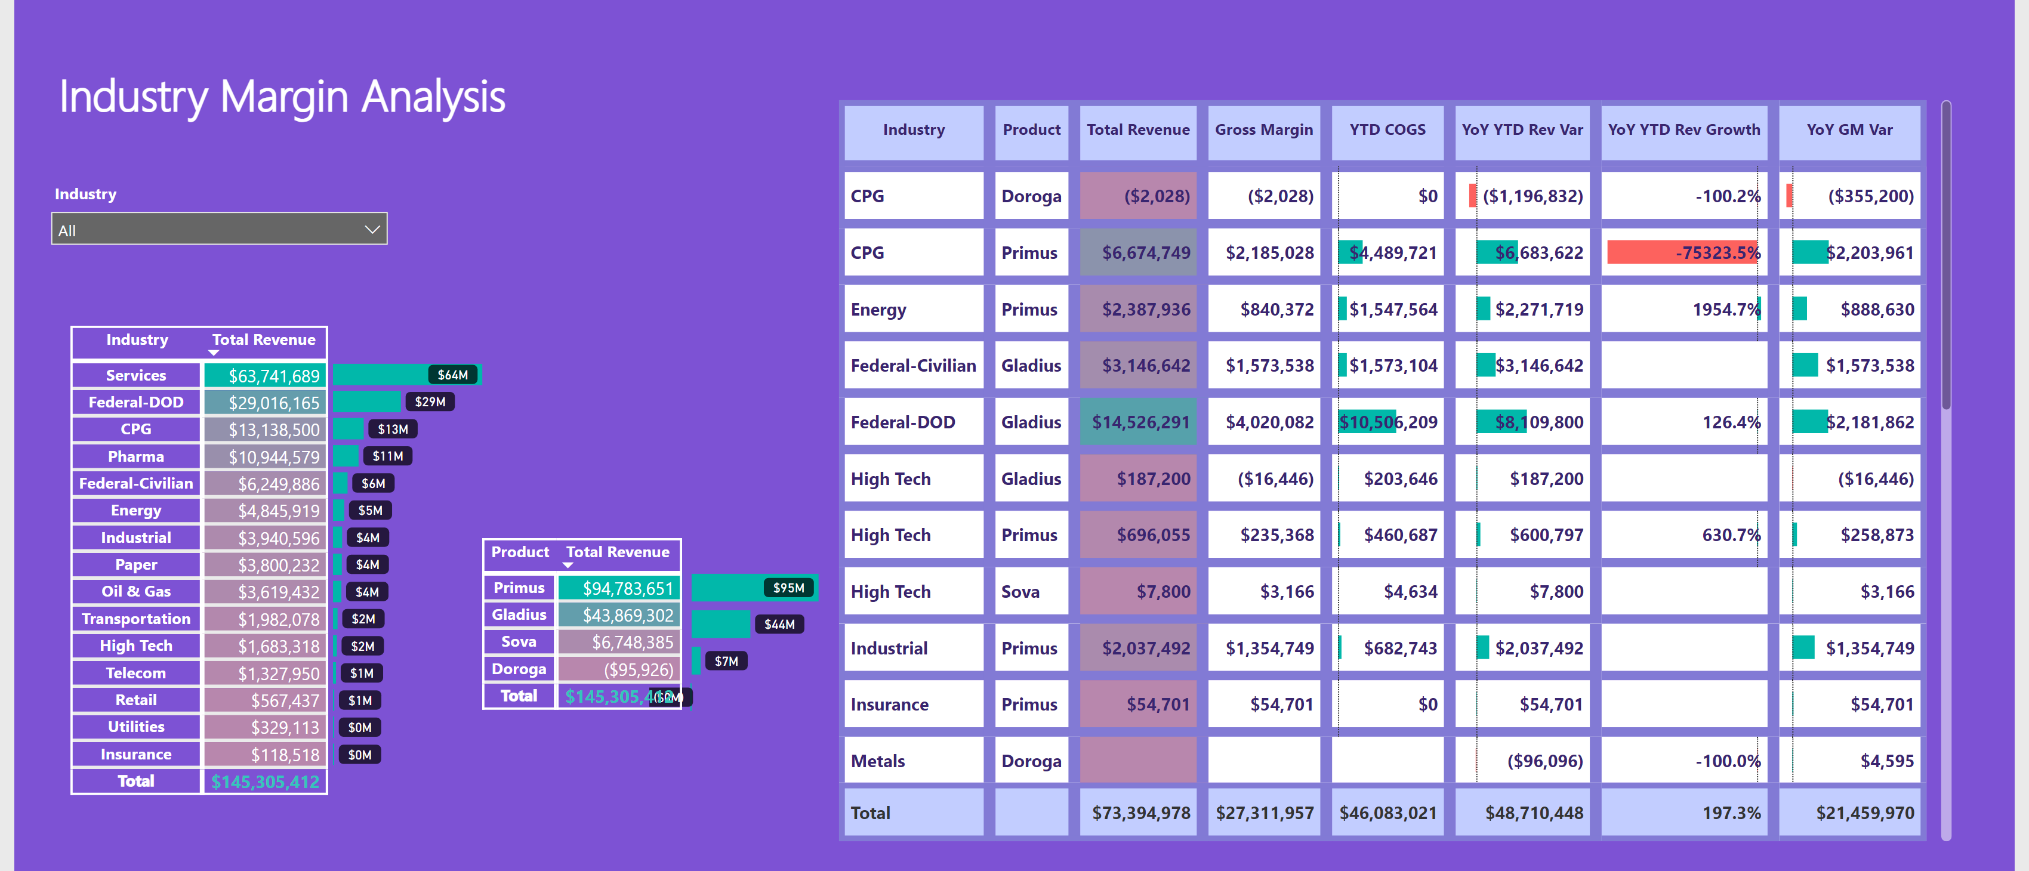
Industry Margin Analysis
Notes:
textbox
No alt text provided
slicer
No alt text provided
clusteredBarChart
No alt text provided
pivotTable
No alt text provided
tableEx
No alt text provided
pivotTable
No alt text provided
clusteredBarChart
No alt text provided

Slide 5
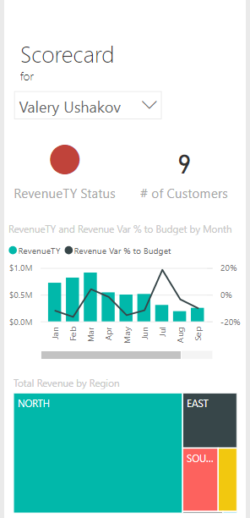
Executive Scorecard
Notes:
textbox
No alt text provided
slicer
No alt text provided
card
No alt text provided
card
No alt text provided
lineStackedColumnComboChart
No alt text provided
treemap
No alt text provided

